Slide 1





GROUP PROJECT

Slide 2


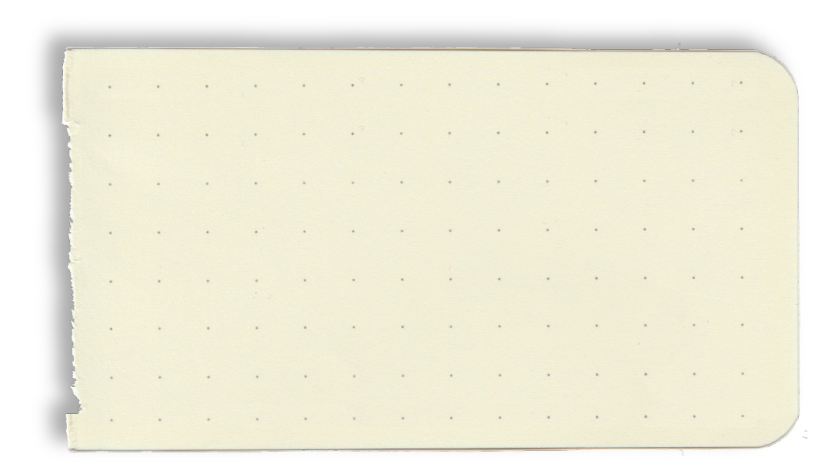

Members
Lê Trọng Vinh ITCSIU23045
Nguyễn Phước Được ITCSIU23005
Nguyễn Đức Quốc Anh ITITWE20018

Slide 3
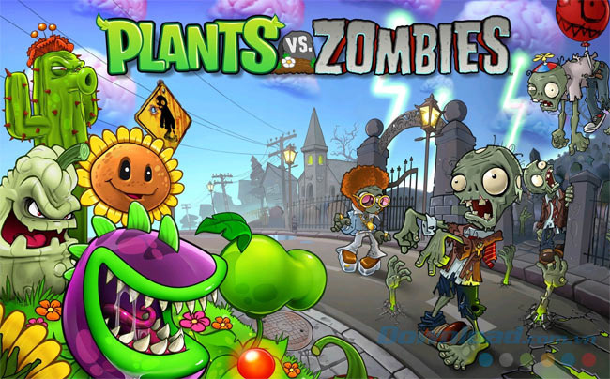
Introduction
Plants vs Zombies was released on 5/5/2009. The game is a tower defense video game developed by PopCap Games.
The object of the game is to collect a currency called "sun" to buy plants. If a zombie passes all your defenses, the level is considered fa﻿iled, and the player will have to restart the level there.

Slide 4
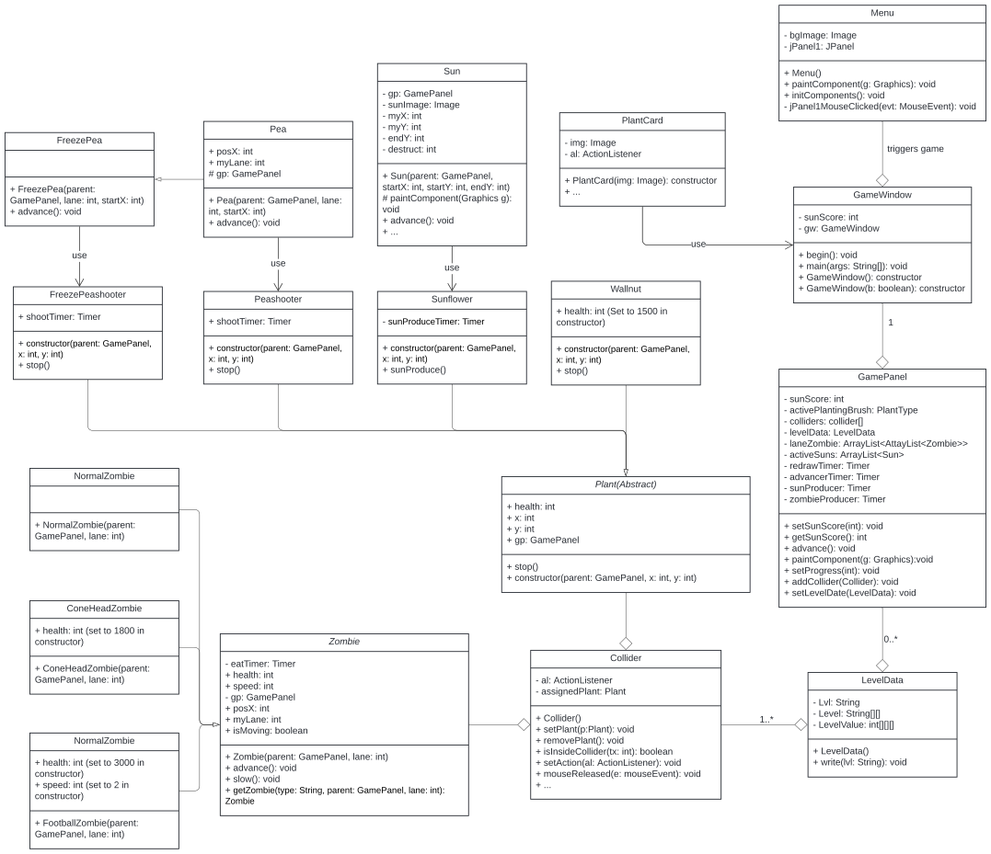
UML:

Slide 5







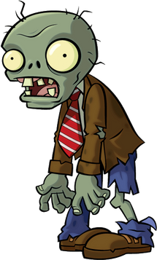
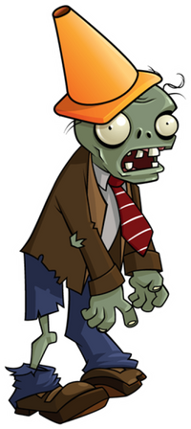

Plants
Items
Zombies
that are used in our projects

Slide 6
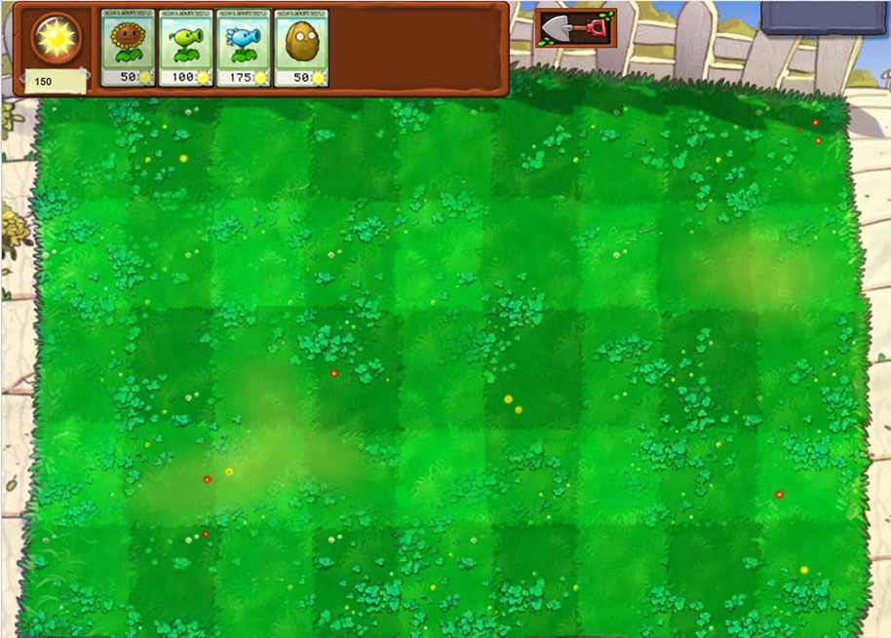
• At the beginning, players should try to develop themselves a lot of Sunflowers to be able to get the sun and earn money to buy weapons:
HOW TO PLAY

Slide 7
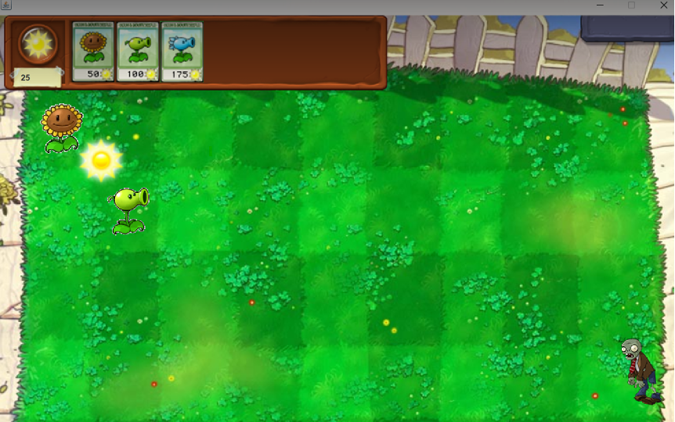

·Every 5s a sun will drop randomly at the top of the game and every 15s a sun will spawn from the sunflower. From there players will use sun to buy peashooter to quickly kill zombies

Slide 8
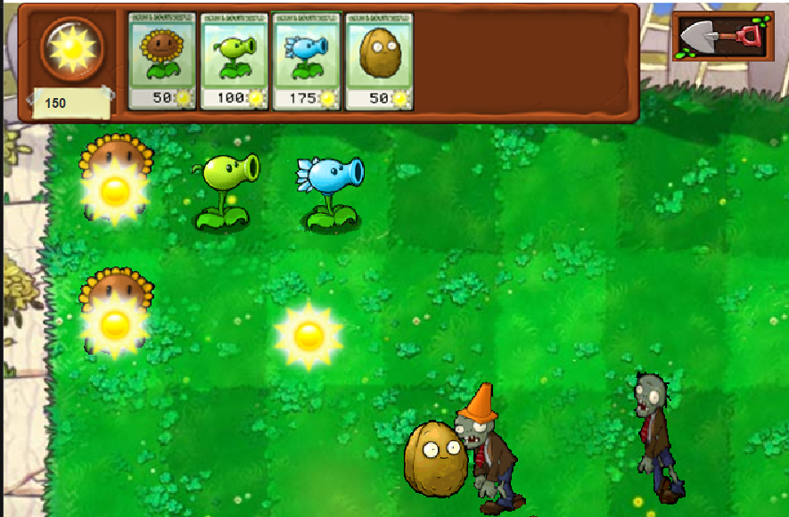
· The difficulty will increase because there is a new stronger zombie, we need to continue to accumulate sun to buy a new type of plants that is freeze peashooter. freeze peashooter can slow down zombies and can buy more time for peashooters to shoot:

Slide 9
PROJECT ANALYSIS

Slide 10
Level Data:
- The class develops a difficult game mode for players.

Slide 11
Key attributes include:
Lvl: is a String data type and it equal to “1”. It means that this is the easy level.
Level [] []: is a String data type and it is created by 2 Arrays. It contains two types of zombies such as: normal zombies, normal zombies, and cone-headed zombies (the second array ensures that the spawn rate of the cone-headed zombies is small and makes the game easier.)
LevelValue [] [] []: is an int data type and it has 3 arrays to make normal zombies appear more than hat-headed zombies.
Methods include:
LevelData(): create a file that stores the levels the player has played.
write(String lvl): to update the data of players who have passed the stage and move on to the next stage.

Slide 12
Game Objects and Their Functions
Exploring interactions between Zombies, Plants, and Peas in the game.

Slide 13
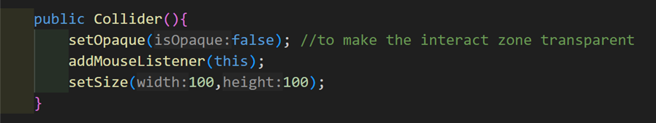
Collider
· Interactive Zones: Each Collider represents one cell (or tile) on the game grid, allowing player interactions such as planting or removing a plant.
· Transparent Layer: Colliders are invisible (setOpaque(false)), so they don't affect the game display.

Slide 14
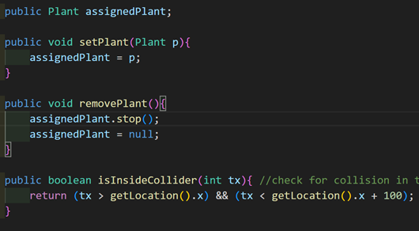
Collider
Core responsibility:
Managing Plants
Handling User Actions
Collision Detection

Slide 15
PLANT CLASS
Blueprint for all plant types

Slide 16
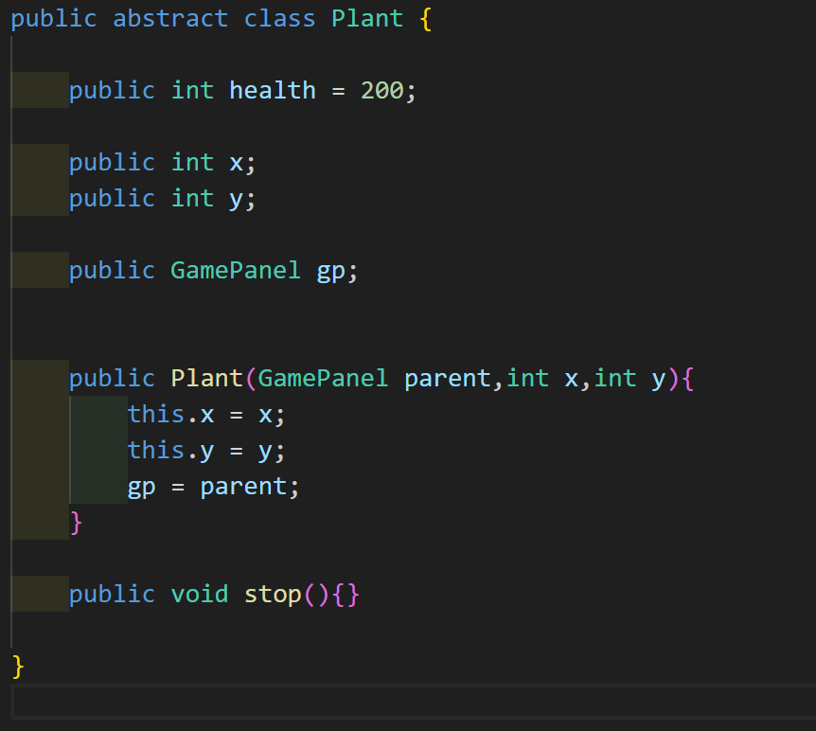
PLANT CLASS
Attributes:
Health: Default 200, reduces with zombie attacks.
Position: x and y define the grid location.
GamePanel Reference (gp): Links plants to game state.
Usage:
Serves as a base for specific plant types.
Provides extensibility for new plant types.

Slide 17
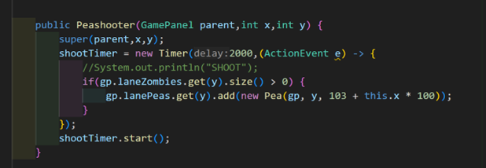
PeaShooter Class
Specialized Plant:
Primary Function: Shoots peas every 2 seconds to attack zombies.
Mechanics:
Checks for zombies in its lane.
Generates Peas at specific intervals.
Methods:
stop(): Stop pea generation when removed.

Slide 18
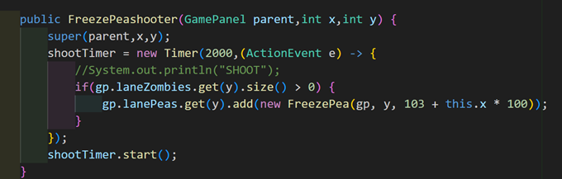
FreezePeaShooter Class
work the same as peashooter
but generate freeze pea instead

Slide 19
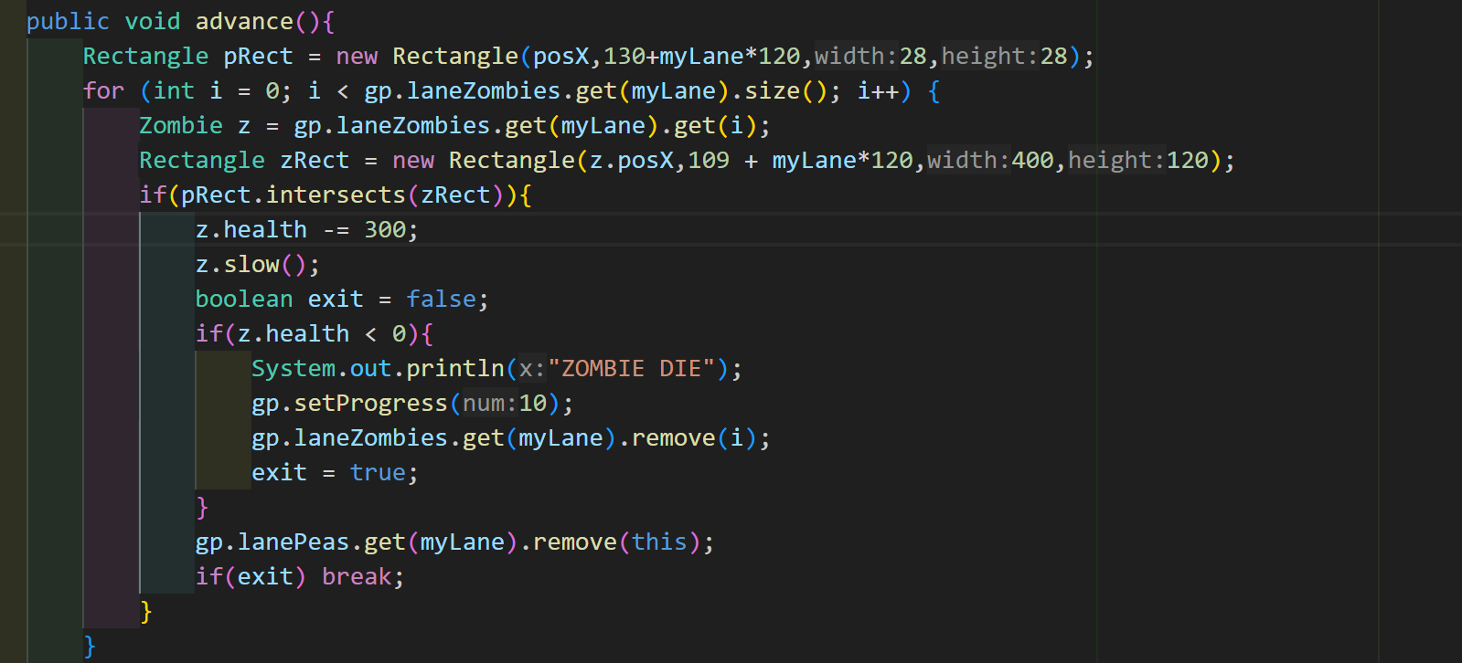
Pea and FreezePea
Pea Class:
Moves forward, damages zombies, and removes itself upon collision.
Attributes: Position, lane, and damage of 300.
FreezePea:
Slows zombies in addition to dealing damage.
Behavior:
Creates a slowing effect.
Integrates with the FreezePeaShooter.

Slide 20
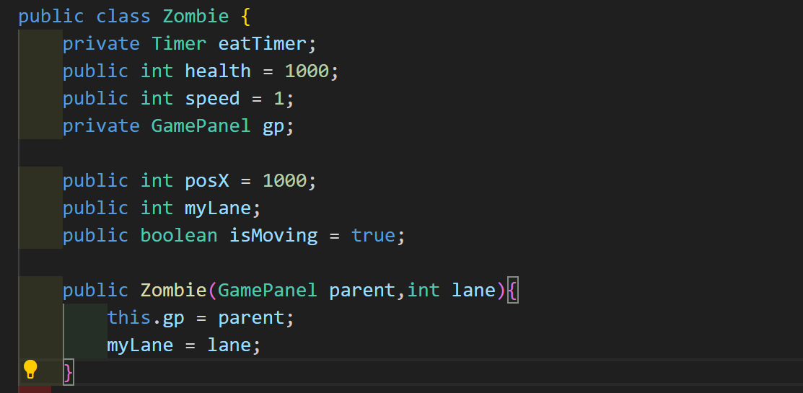
Zombie class
Attributes:
Health (default 1000),
Speed (default 1)

Slide 21
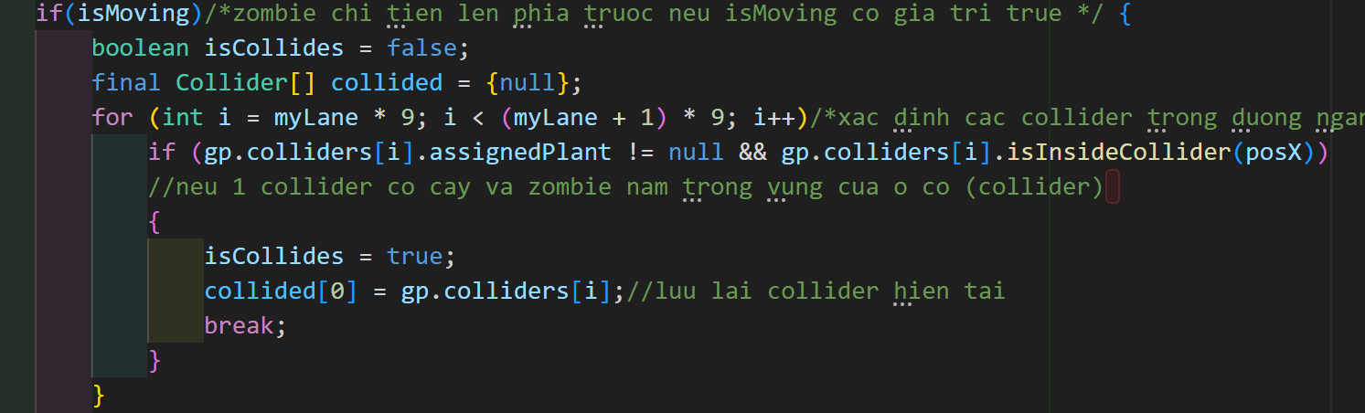
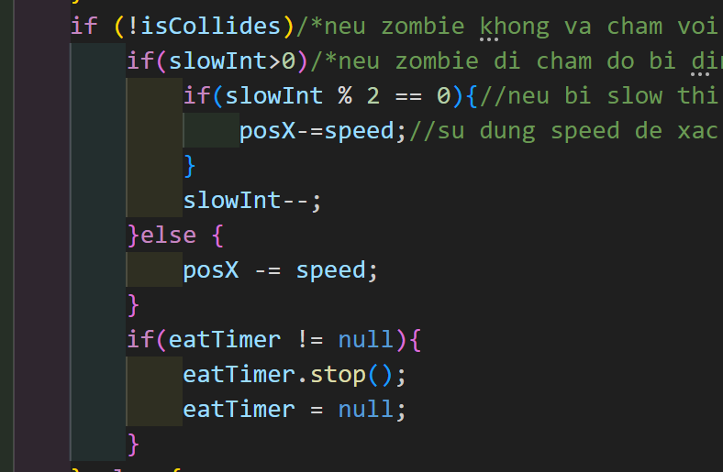
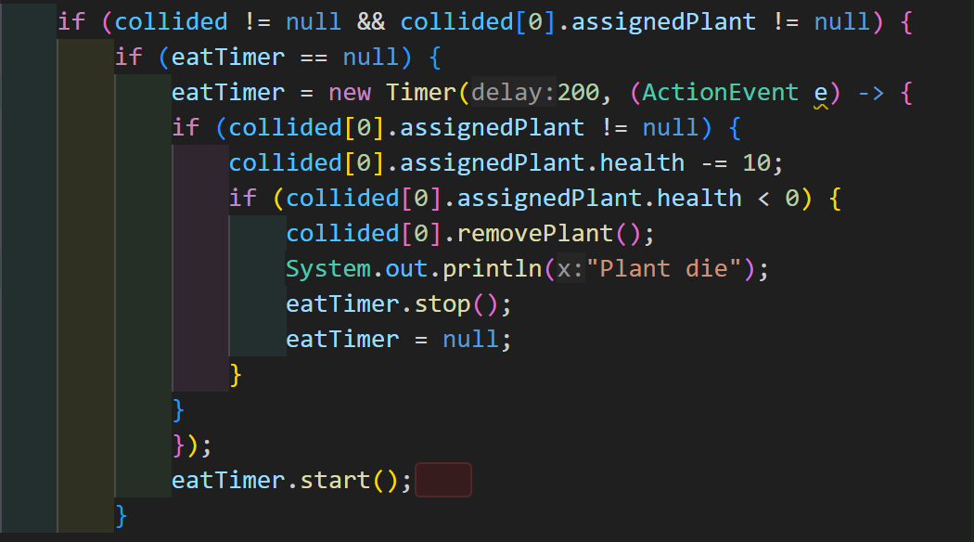
Zombie class

Slide 22
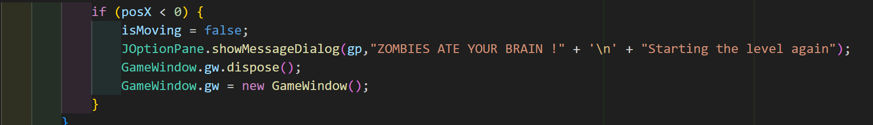
Zombie class
if zom pass the defence the game, you loss

Slide 23
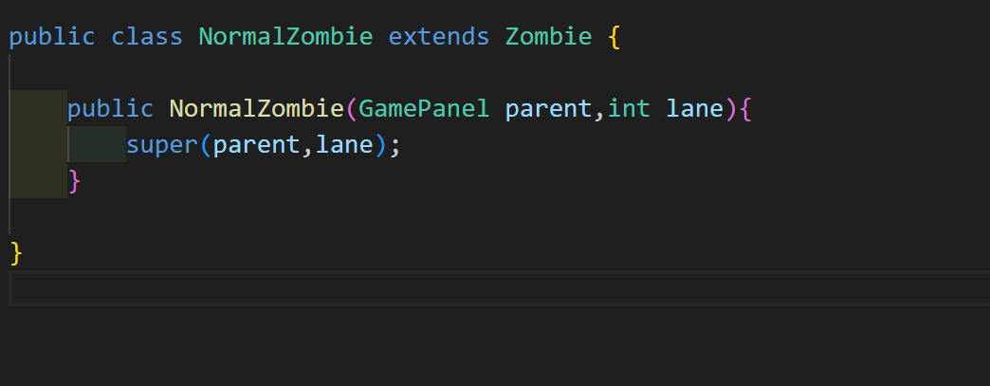
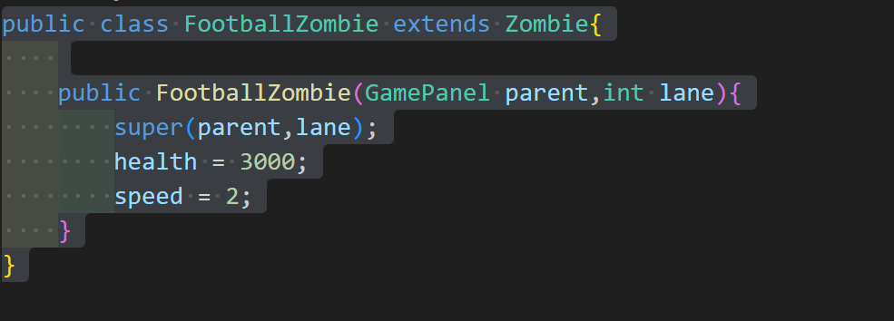
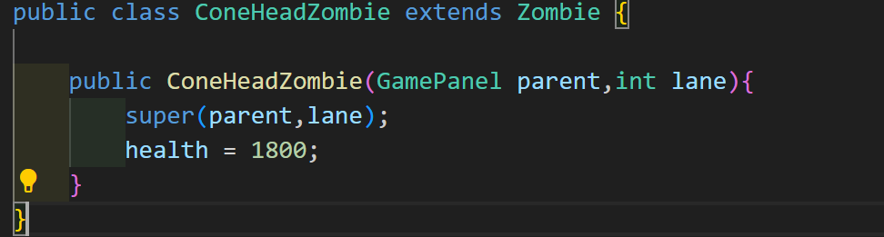
zombie class

Slide 24
Game Panel
Rendering game elements (plants, zombies, background)
Managing player inputs
Handling game events and states

Slide 25
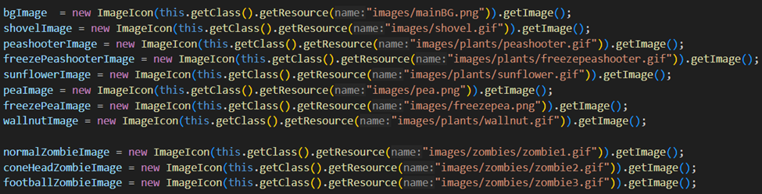
Images and Assets
Use of external images for graphical elements
Loading resources for plants, zombies, and background

Slide 26
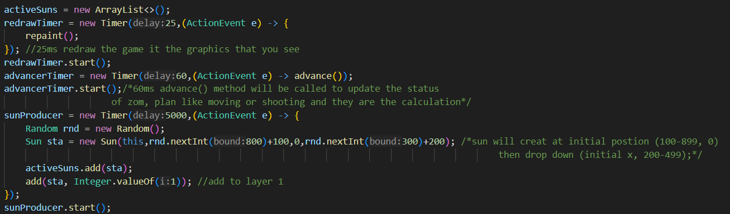
Core Gameplay Loop
Timers for game updates (redraw, advance) and sun production

Slide 27
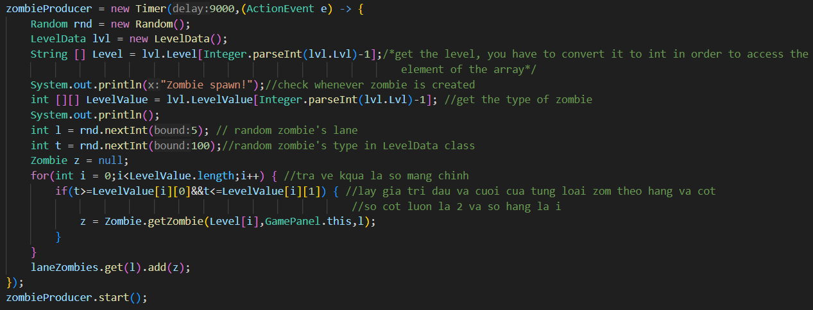
Core Gameplay Loop
zombie spawming

Slide 28
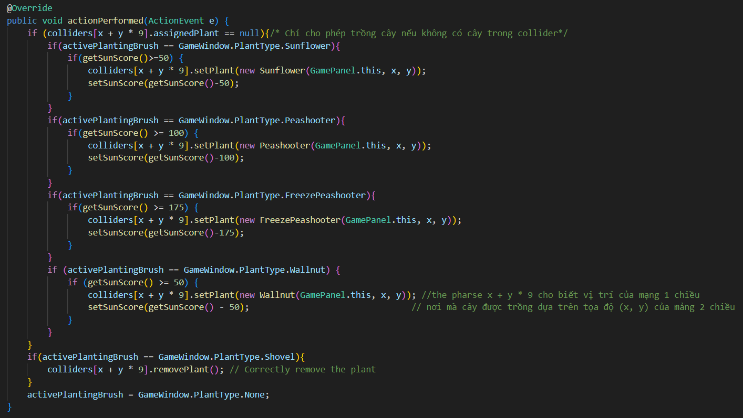
Handling Planting and Interaction
Planting mechanics (brush, sun score)
Plant placement via mouse clicks
remove plant

Slide 29
Handling Planting and Interaction
Planting mechanics (brush, sun score)
Plant placement via mouse clicks
remove plant

Slide 30
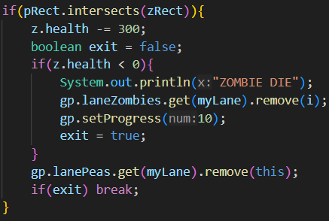
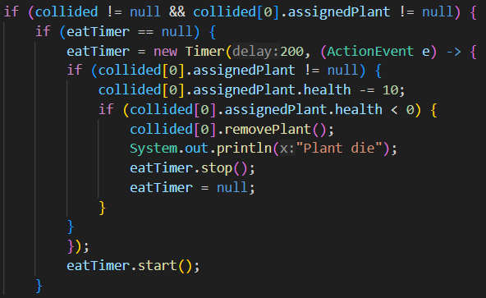
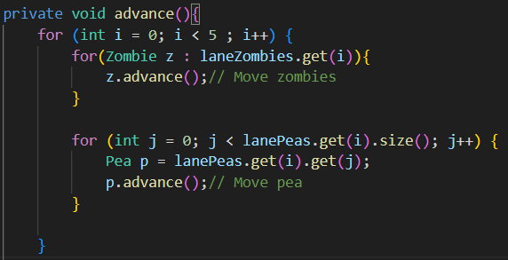
Zombie and Plant Interaction
Zombies move through lanes and get damaged by plants
Peashooters shoot peas at zombies

Slide 31
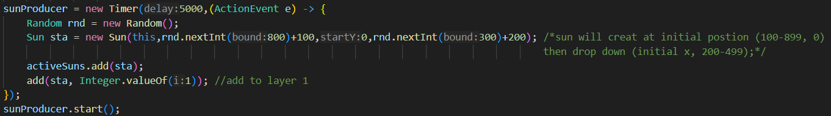
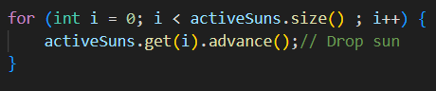
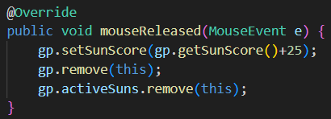
Sun Production and Collection
Sunflowers produce sun over time.
Sun falls from the sky and can be collected by the player.

Slide 32
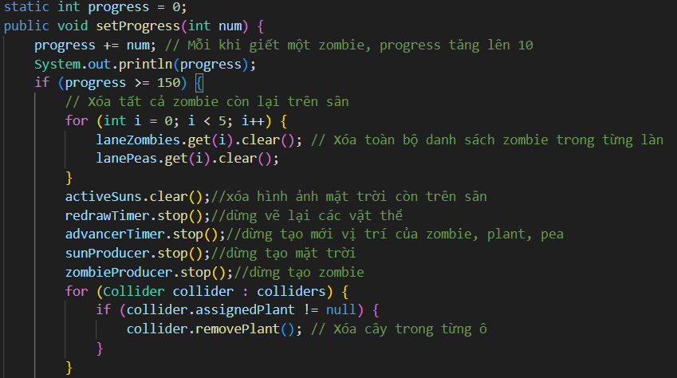
Endgame and Level Transition

Slide 33
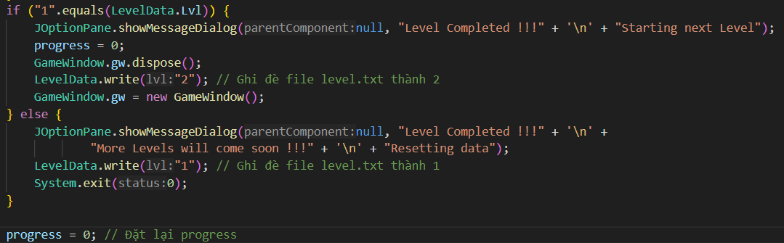
Endgame and Level Transition
Progress bar tracks completion
Level transition upon 15 zombie defeated and clear all things from last level

Slide 34


